Slide 1
Module 2
Stream & Block Cipher
Feistal Structure
DES

Slide 2
Stream & Block Cipher
Stream cipher
A stream cipher is one that encrypts a digital data stream one bit or one byte at a time. Examples
Autokeyed Vigenère cipher
Vernam cipher

Slide 3
Stream & Block Cipher
Block cipher
A block cipher is one in which a block of plaintext is treated as a whole and used to produce a ciphertext block of equal length.
Typically, a block size of 64 or 128 bits is used.
It operates on a plaintext block of n bits to produce a ciphertext block of n bits.
Feistel cipher structure

Slide 4
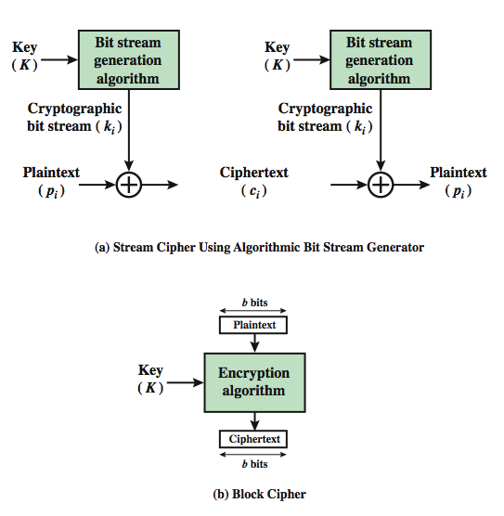
Stream & Block Cipher

Slide 5
Feistel Cipher
It is an ideal block cipher by utilizing the concept of a product cipher, which is the execution of two or more simple ciphers in sequence in such a way that the final result or product is cryptographically stronger than any of the component ciphers.
The ideal block cipher is a cipher it allows for the maximum number of possible encryption mappings from the plaintext block.
Aim is to develop a block cipher with a key length of k bits and a block length of n bits, allowing a total of 2 ̂k possible transformations

Slide 6
Diffusion & Confusion
Two basic building blocks for any cryptographic system.
Diffusion
The statistical structure of the plaintext is dissipated into long-range statistics of the ciphertext.
This is achieved by having each plaintext digit affect the value of many ciphertext digits; generally this is equivalent to having each ciphertext digit be affected by many plaintext digits.
Diffusion is achieved through permutations.

Slide 7
Diffusion & Confusion
Confusion
It seeks to make the relationship between the statistics of the ciphertext and the value of the encryption key as complex as possible, again to thwart attempts to discover the key.
Thus, even if the attacker can get some handle on the statistics of the ciphertext, the way in which the key was used to produce that ciphertext is so complex as to make it difficult to deduce the key.
This is achieved by the use of a complex substitution algorithm.

Slide 8
Feistel Cipher Structure
The inputs to the encryption algorithm are a plaintext block of length 2w bits and a key K.
The plaintext block is divided into two halves, L0 and R0.
The two halves of the data pass through n rounds of processing and then combine to produce the ciphertext block.
Each round i has as inputs Li-1 and Ri-1, derived from the previous round, as well as a subkey Ki, derived from the overall K.
The subkeys Ki are different from K and from each other.

Slide 9
Feistel Cipher Structure
All rounds have the same structure.
A substitution is performed on the left half of the data. This is done by applying a round function F to the right half of the data and then taking the exclusive-OR of the output of that function and the left half of the data.
The round function has the same general structure for each round but is parameterized by the round subkey Ki.
Following this substitution, a permutation is performed that consists of the interchange of the two halves of the data.
This structure is a particular form of the substitution-permutation network (SPN) proposed by Shannon.

Slide 10
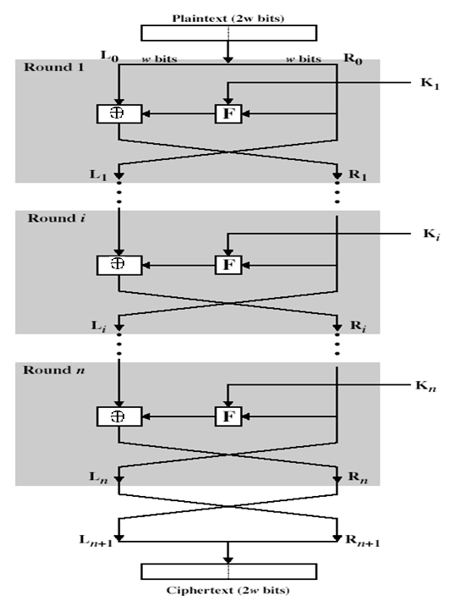
Feistel Cipher Structure

Slide 11
Feistel Cipher Design Features
Block size:
Larger block sizes mean greater security but reduced encryption/decryption speed.
The greater security is achieved by greater diffusion.
Traditionally, block size is of 64 bits .
Key size:
Larger key size means greater security but may decrease encryption/decryption speed.
The greater security is by greater resistance to brute-force attacks and greater confusion.
Key sizes of 64 bits or less are now widely considered to be inadequate, and 128 bits has become a common size.
Number of rounds:
The essence of the Feistel cipher is that a single round offers inadequate security but that multiple rounds offer increasing security.
A typical size is 16 rounds.
Subkey generation algorithm:
Greater complexity in this algorithm should lead to greater difficulty of cryptanalysis.
Round function:
Greater complexity generally means greater resistance to cryptanalysis.

Slide 12
Feistel Cipher Design Features
There are two other considerations in the design of a Feistel cipher:
Fast software encryption/decryption
Speed of execution of the algorithm
Ease of analysis
Make the algorithm as complex as possible

Slide 13
Feistel Decryption Algorithm
The process of decryption with a Feistel cipher is essentially the same as the encryption process.
The rule is as follows: Use the ciphertext as input to the algorithm, but use the subkeys Ki in reverse order.
That is, use Kn in the first round, Kn-1 in the second round, and so on until K1 is used in the last round.
For clarity, we use the notation LEi and REi for data traveling through the encryption algorithm and LDi and RDi for data traveling through the decryption algorithm.
The diagram indicates that, at every round, the intermediate value of the decryption process is equal to the corresponding value of the encryption process with the two halves of the value swapped.

Slide 14
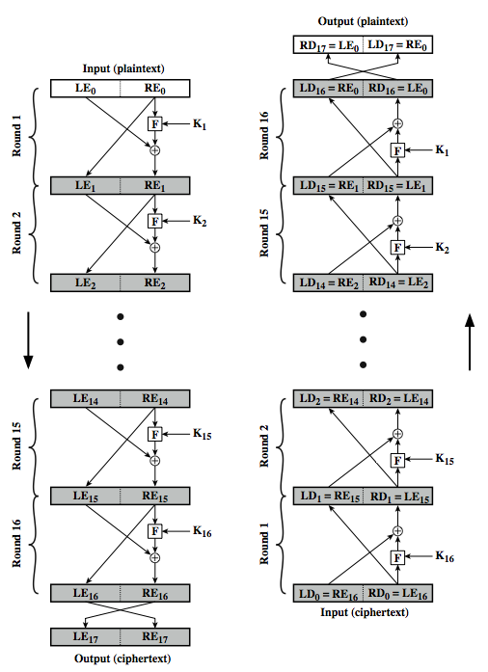
Feistel Decryption Algorithm

Slide 15
Feistel Decryption Algorithm
After the last iteration of the encryption process, the two halves of the output are swapped, so that the ciphertext is RE16||LE16. The output of that round is the ciphertext.
Now take that ciphertext and use it as input to the same algorithm. The input to the first round is RE16||LE16, which is equal to the 32-bit swap of the output of the sixteenth round of the encryption process.

Slide 16
Feistel Encryption/Decryption Algorithm
Encryption
LEi = REi-1
REi = LEi-1 ⊕ F(REi-1, Ki)
Decryption
LDi = RDi-1
RDi =LDi-1 ⊕ F(RDi-1, K17-i)
LDi = RE16-i
RDi = LE16-i

Slide 17
Data Encryption Standard (DES)
Most widely used block cipher in world
Adopted in 1977 by NBS (now NIST)
as FIPS PUB 46
Encrypts 64-bit data using 56-bit key
Has widespread use
Has been considerable controversy over its security.

Slide 18
DES History
IBM developed Lucifer cipher
by team led by Feistel
used 64-bit data blocks with 128-bit key
Then redeveloped as a commercial cipher with input from NSA and others
In 1973 NBS issued request for proposals for a national cipher standard
IBM submitted their revised Lucifer which was eventually accepted as the DES

Slide 19
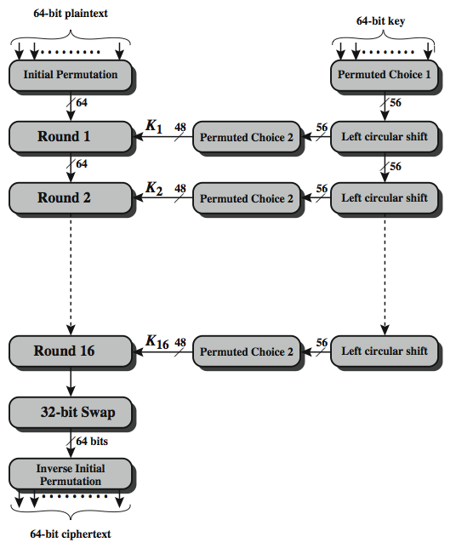
DES Encryption
Notes:
The basic process in enciphering a 64-bit data block using the DES, shown on the left side, consists of:
- an initial permutation (IP)
- 16 rounds of a complex key dependent round function involving substitution and permutation functions
- a final permutation, being the inverse of IP
The right side shows the handling of the 56-bit key and consists of:
- an initial permutation of the key (PC1) which selects 56-bits in two 28-bit halves
- 16 stages to generate the subkeys using a left circular shift and a permutation

Slide 20
DES Encryption
The processing of the plaintext proceeds in three phases.
An initial permutation (IP)
16 rounds of a complex key dependent calculation f
A final permutation, being the inverse of IP

Slide 21
DES Encryption
First, the 64-bit plaintext passes through an initial permutation (IP) that rearranges the bits to produce the permuted input.
This is followed by a phase consisting of 16 rounds of the same function, which involves both permutation and substitution functions. The output of the last (sixteenth) round consists of 64 bits that are a function of the input plaintext and the key. The left and right halves of the output are swapped to produce the preoutput.
Finally, the preoutput is passed through a permutation (IP ̂ -1) that is the inverse of the initial permutation function, to produce the 64-bit ciphertext.
With the exception of the initial and final permutations, DES has the exact structure of a Feistel cipher.
The right-hand portion shows the way in which the 56-bit key is used. Initially, the key is passed through a permutation function. Then, for each of the 16 rounds, a subkey (Ki) is produced by the combination of a left circular shift and a permutation. The permutation function is the same for each round, but a different subkey is produced because of the repeated shifts of the key bits.

Slide 22
Initial Permutation (IP)
The initial permutation and its inverse are defined by tables.
The input to a table consists of 64 bits numbered from 1 to 64.
IP reorders the input data bits.
The 64 entries in the permutation table contain a permutation of the numbers from 1 to 64.
Each entry in the permutation table indicates the position of a numbered input bit in the output, which also consists of 64 bits.

Slide 23
Initial Permutation (IP)
View the input as M: 8 by 8 matrix
Transform M into M1 in two steps
Transpose row x into column (9-x), 0<x<9
Apply permutation on the rows:
For even column y, it becomes row y/2
For odd column y, it becomes row (5+y/2)

Slide 24
Initial Permutation (IP) Input Data/Plaintext Input
1 | 2 | 3 | 4 | 5 | 6 | 7 | 8
9 | 10 | 11 | 12 | 13 | 14 | 15 | 16
17 | 18 | 19 | 20 | 21 | 22 | 23 | 24
25 | 26 | 27 | 28 | 29 | 30 | 31 | 32
33 | 34 | 35 | 36 | 37 | 38 | 39 | 40
41 | 42 | 43 | 44 | 45 | 46 | 47 | 48
49 | 50 | 51 | 52 | 53 | 54 | 55 | 56
57 | 58 | 59 | 60 | 61 | 62 | 63 | 64

Slide 25
Initial Permutation (IP) Output Data
58 | 50 | 42 | 34 | 26 | 18 | 10 | 2
60 | 52 | 44 | 36 | 28 | 20 | 12 | 4
62 | 54 | 46 | 38 | 30 | 22 | 14 | 6
64 | 56 | 48 | 40 | 32 | 24 | 16 | 8
57 | 49 | 41 | 33 | 25 | 17 | 9 | 1
59 | 51 | 43 | 35 | 27 | 19 | 11 | 3
61 | 53 | 45 | 37 | 29 | 21 | 13 | 5
63 | 55 | 47 | 39 | 31 | 23 | 15 | 7

Slide 26
Final/Inverse Initial Permutation(IP ^-1)
40 | 8 | 48 | 16 | 56 | 24 | 64 | 32
39 | 7 | 47 | 15 | 55 | 23 | 63 | 31
38 | 6 | 46 | 14 | 54 | 22 | 62 | 30
37 | 5 | 45 | 13 | 53 | 21 | 61 | 29
36 | 4 | 44 | 12 | 52 | 20 | 60 | 28
35 | 3 | 43 | 11 | 51 | 19 | 59 | 27
34 | 2 | 42 | 10 | 50 | 18 | 58 | 26
33 | 1 | 41 | 9 | 49 | 17 | 57 | 25

Slide 27
Expansion Permutation (E)
Output of IP is divided into 2 halves- L,R
First the right half goes through an expansion permutation which expands it from 32 to 48 bits.
This makes it the same length as the subkey to allow the XOR, but it also demonstrates an important concept in cryptography. In expanding to 1.5 times its size, several bits are repeated (no new bits are introduced - all the existing bits are shifted around, and some are used twice).
Because of this some of the input bits affect two output bits instead of one, the goal being to have every output bit in DES depend upon every input bit as quickly as possible. This is known as the avalanche effect.

Slide 28
Expansion Permutation (E)
32 | 1 | 2 | 3 | 4 | 5
4 | 5 | 6 | 7 | 8 | 9
8 | 9 | 10 | 11 | 12 | 13
12 | 13 | 14 | 15 | 16 | 17
16 | 17 | 18 | 19 | 20 | 21
20 | 21 | 22 | 23 | 24 | 25
24 | 25 | 26 | 27 | 28 | 29
28 | 29 | 30 | 31 | 32 | 1

Slide 29
Permutation Function (P)
16 | 7 | 20 | 21 | 29 | 12 | 28 | 17
1 | 15 | 23 | 26 | 5 | 18 | 31 | 10
2 | 8 | 24 | 14 | 32 | 27 | 3 | 9
19 | 13 | 30 | 6 | 22 | 11 | 4 | 25

Slide 30
Details of Single Round
The left and right halves of each 64-bit intermediate value are treated as separate 32-bit quantities, labeled L (left) and R (right).
As in any classic Feistel cipher, the overall processing at each round can be summarized in the following formulas:
LEi = REi-1
REi = LEi-1 ⊕ F(REi-1, Ki)

Slide 31
Single Round of DES Algorithm
32 bits
32 bits
28 bits
28 bits
Li-1
Ri-1
Ci-1
Di-1
32 bits
Expansion Permutation (E-Table)
Left Shift(s)
Left Shift(s)
48 bits
F
XOR
48 bits
Permutation Choice (PC-2)
Ki
48 bits
Substitution Box (S-Box)
32 bits
Permutation Box (P)
32 bits
XOR
32 bits
Li
Ri
Ci
Di

Slide 32
Single Round of DES Algorithm
The round key Ki is 48 bits. The R input is 32 bits. This R input is first expanded to 48 bits by using a table that defines a permutation plus an expansion that involves duplication of 16 of the R bits.
The resulting 48 bits are XORed with Ki. This 48-bit result passes through a substitution function that produces a 32-bit output.
The substitution consists of a set of eight S-boxes, each of which accepts 6 bits as input and produces 4 bits as output.

Slide 33
Single Round of DES Algorithm
These transformations are defined in the following slides, which is interpreted as follows:
The first and last bits of the input to box Si form a 2-bit binary number to select one of four substitutions defined by the four rows in the table for Si.
The middle four bits select one of the sixteen columns. The decimal value in the cell selected by the row and column is then converted to its 4-bit representation to produce the output.
For example, in S1 for input 011001, the row is 01 (row 1) and the column is 1100 (column 12). The value in row 1, column 12 is 9, so the output is 1001.

Slide 34
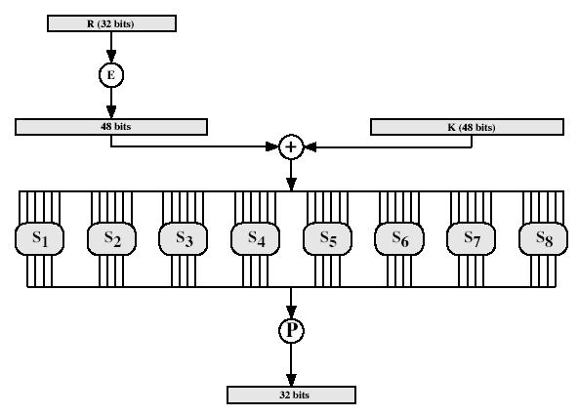
Calculation of F(R,K)

Slide 35
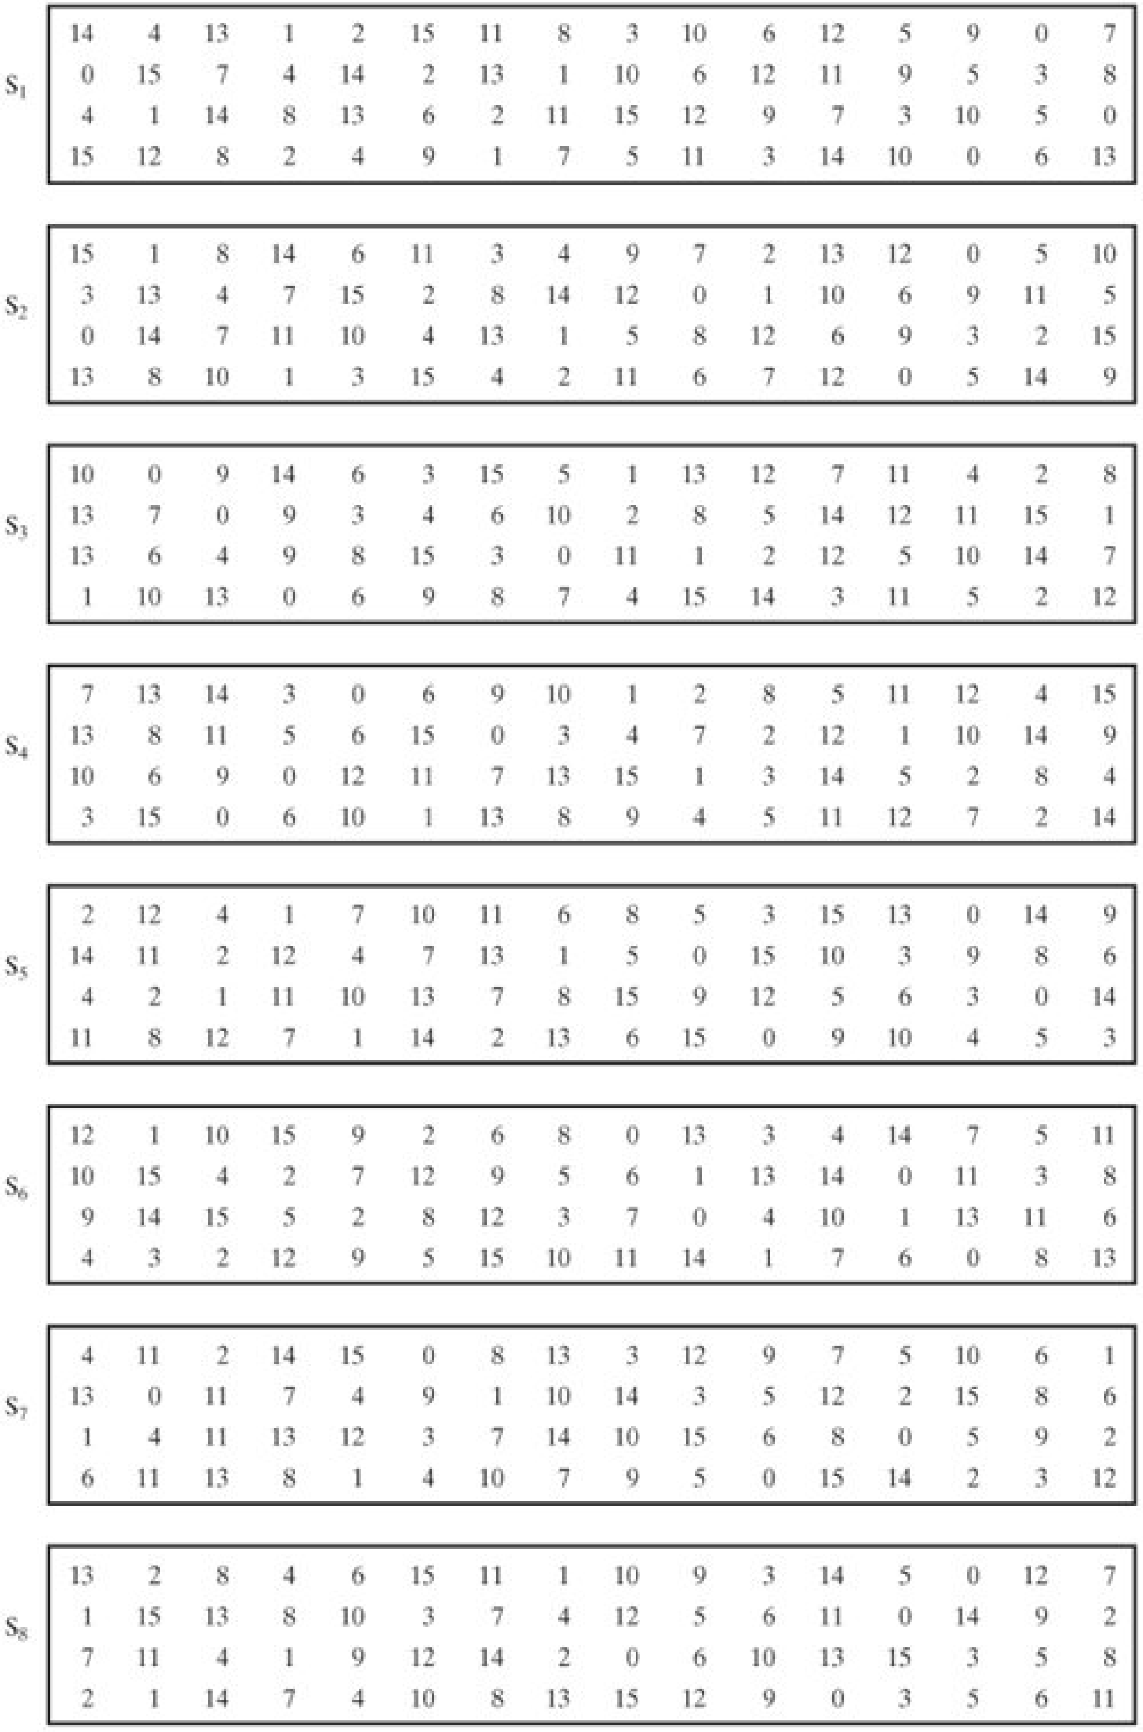
Definition of DES S-Boxes

Slide 36
Key Generation
A 64-bit key is used as input to the algorithm. The bits of the key are numbered from 1 through 64; every eighth bit is ignored.
The key is first subjected to a permutation governed by a table labeled Permuted Choice One.
The resulting 56-bit key is then treated as two 28-bit quantities, labeled C0 and D0. At each round, Ci-1 and Di-1 are separately subjected to a circular left shift or (rotation) of 1 or 2 bits. These shifted values serve as input to the next round.
They also serve as input to the part labeled Permuted Choice Two, which produces a 48-bit output that serves as input to the function F(Ri-1, Ki).

Slide 37
Input Key
1 | 2 | 3 | 4 | 5 | 6 | 7 | 8
9 | 10 | 11 | 12 | 13 | 14 | 15 | 16
17 | 18 | 19 | 20 | 21 | 22 | 23 | 24
25 | 26 | 27 | 28 | 29 | 30 | 31 | 32
33 | 34 | 35 | 36 | 37 | 38 | 39 | 40
41 | 42 | 43 | 44 | 45 | 46 | 47 | 48
49 | 50 | 51 | 52 | 53 | 54 | 55 | 56
57 | 58 | 59 | 60 | 61 | 62 | 63 | 64

Slide 38
Permuted Choice-1 (PC-1)
57 | 49 | 41 | 33 | 25 | 17 | 9
1 | 58 | 50 | 42 | 34 | 26 | 18
10 | 2 | 59 | 51 | 43 | 35 | 27
19 | 11 | 3 | 60 | 52 | 44 | 36
63 | 55 | 47 | 39 | 31 | 23 | 15
7 | 62 | 54 | 46 | 38 | 30 | 22
14 | 6 | 61 | 53 | 45 | 37 | 29
21 | 13 | 5 | 28 | 20 | 12 | 4

Slide 39
Permuted Choice Two (PC-2)
14 | 17 | 11 | 24 | 1 | 5 | 3 | 28
15 | 6 | 21 | 10 | 23 | 19 | 12 | 4
26 | 8 | 16 | 7 | 27 | 20 | 13 | 2
41 | 52 | 31 | 37 | 47 | 55 | 30 | 40
51 | 45 | 33 | 48 | 44 | 49 | 39 | 56
34 | 53 | 46 | 42 | 50 | 36 | 29 | 32

Slide 40
Schedule of Left Shifts
Round Number | 1 | 2 | 3 | 4 | 5 | 6 | 7 | 8 | 9 | 10 | 11 | 12 | 13 | 14 | 15 | 16
Bits Rotated | 1 | 1 | 2 | 2 | 2 | 2 | 2 | 2 | 1 | 2 | 2 | 2 | 2 | 2 | 2 | 1

Slide 41
DES Decryption
As with any Feistel cipher, decryption uses the same algorithm as encryption, except that the application of the subkeys is reversed.

Slide 42
Avalanche Effect
Avalanche Effect is a property of any encryption algorithm that a small change in either the plaintext or the key should produce a significant change in the ciphertext.
In particular, a change in one bit of the plaintext or one bit of the key should produce a change in many bits of the ciphertext.
DES exhibits a strong avalanche effect

Slide 43
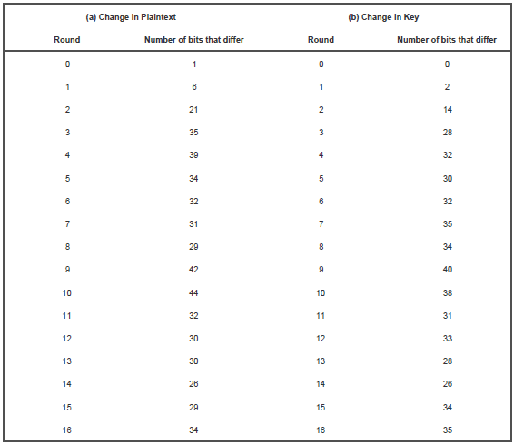
Avalanche Effect in DES

Slide 44
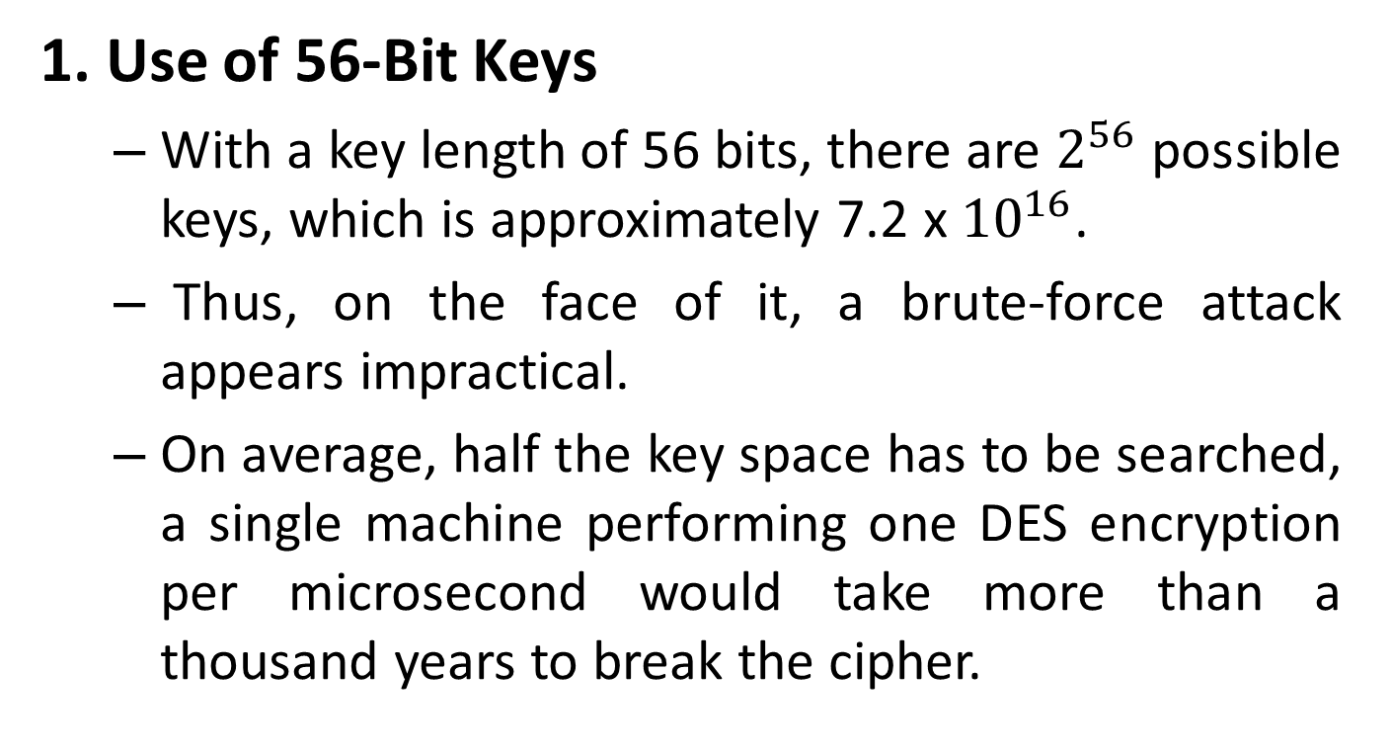
Strength of DES
1. Use of 56-Bit Keys
With a key length of 56 bits, there are $2^{56}$ possible keys, which is approximately 7.2 x ${10}^{16}$.
Thus, on the face of it, a brute-force attack appears impractical.
On average, half the key space has to be searched, a single machine performing one DES encryption per microsecond would take more than a thousand years to break the cipher.

Slide 45
Strength of DES
2. Nature of the DES Algorithm
Cryptanalysis is possible by exploiting the characteristics of the DES algorithm.
The focus of concern has been on the eight substitution tables, or S-boxes, that are used in each iteration.
Because the design criteria for these boxes, and indeed for the entire algorithm, were not made public, there is a suspicion that the boxes were constructed in such a way that cryptanalysis is possible for an opponent who knows the weaknesses in the S-boxes.

Slide 46
Timing Attacks
A timing attack is one in which information about the key or the plaintext is obtained by observing how long it takes a given implementation to perform decryptions on various ciphertexts.
A timing attack exploits the fact that an encryption or decryption algorithm often takes slightly different amounts of time on different inputs.
DES appears to be fairly resistant to a successful timing attack but suggest some avenues to explore.

Slide 47
Multiple Encryption and Triple DES
Multiple encryption is a technique in which an encryption algorithm is used multiple times.
In the first instance, plaintext is converted to ciphertext using the encryption algorithm.
This ciphertext is then used as input and the algorithm is applied again.
This process may be repeated through any number of stages.

Slide 48
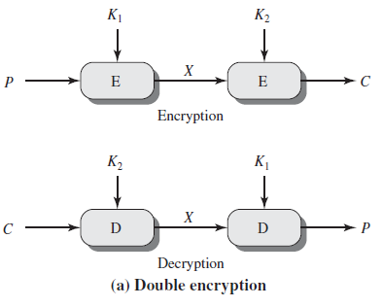
Double DES / Double Encryption
C = E(K2, E(K1, P))
P = D(K1, D(K2, C))

Slide 49
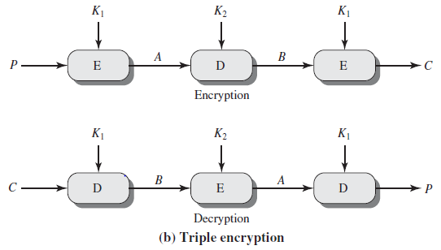
Triple DES / Triple Encryption
With Two Keys
C = E(K1, D(K2, E(K1, P)))
P = D(K1, E(K2, D(K1, C)))

Slide 50
Triple DES
With One Key
C = E(K1, D(K1, E(K1, P))) = E(K1, P)
P = D(K1, E(K1, D(K1, C))) = D(K1, C)
With Three Keys
C = E(K3, D(K2, E(K1, P)))
P = D(K3, E(K2, D(K1, P)))

Slide 51
Prime Numbers
A prime number is divisible only by 1 and itself.
An integer p>1 is a prime number if and only if its only divisors are ±1 and ±p.
For example: {2, 3, 5, 7, 11, 13, 17, …}
1 could also be considered prime, but it’s not very useful.

Slide 52
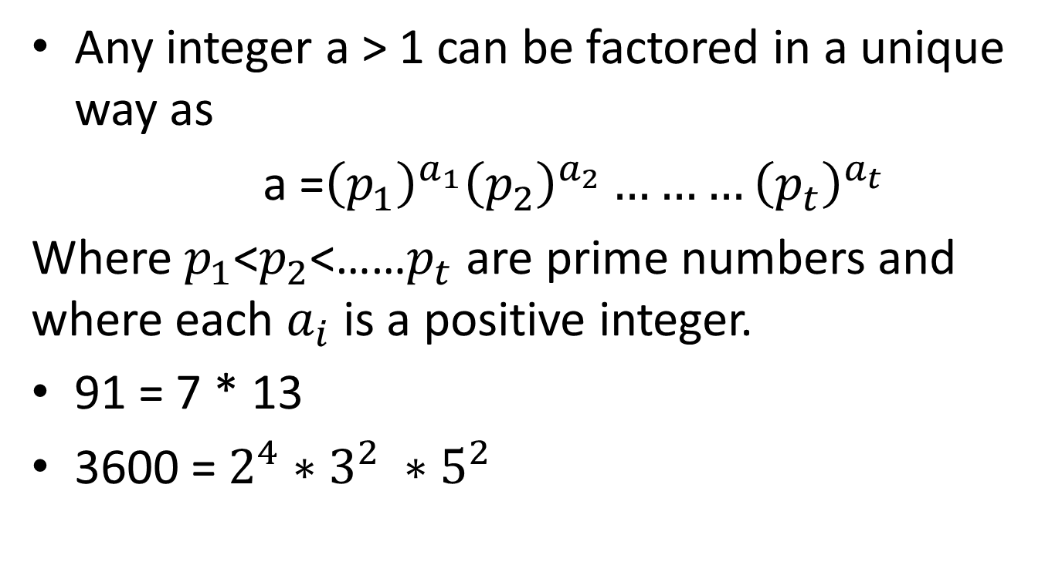
Fundamental Theorem of Arithmetic
Any integer a > 1 can be factored in a unique way as
a =${\left(p_{1}\right)}^{a_{1}}{\left(p_{2}\right)}^{a_{2}}………{\left(p_{t}\right)}^{a_{t}}$
Where $p_{1}$<$p_{2}$<……$p_{t}$ are prime numbers and where each $a_{i}$ is a positive integer.
91 = 7 * 13
3600 = $2^{4}∗3^{2} ∗5^{2}$

Slide 53
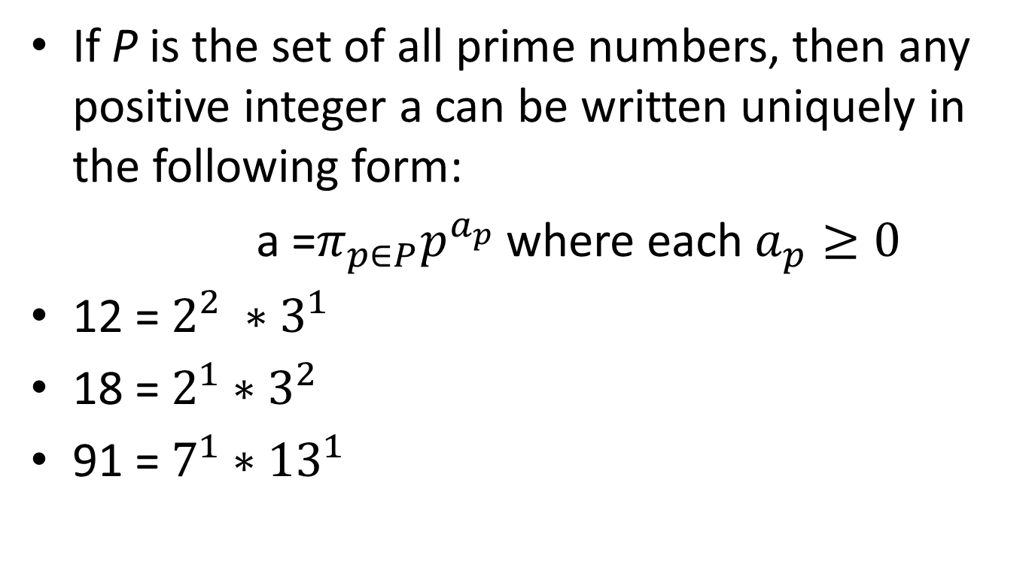
Prime Factorization
If P is the set of all prime numbers, then any positive integer a can be written uniquely in the following form:
a =$π_{p∈P}p^{a_{p}}$where each $a_{p}≥0$
12 = $2^{2} ∗3^{1}$
18 = $2^{1}∗3^{2}$
91 = $7^{1}∗{13}^{1}$

Slide 54
GCD (Greatest Common Divisor)
The greatest common divisor of integers a and b, expressed gcd(a,b), is an integer c that divides both a and b without remainder and that any divisor of a and b is a divisor of c.

Slide 55
GCD
The GCD of two numbers can be determined by comparing their prime factorizations and selecting the least powers.
Eg: 125 & 200
125 = 5³ and 200 = 2³ * 5²
GCD(125, 200) = 2⁰ * 5² = 25

Slide 56
Relatively Prime Numbers
Two numbers are relatively prime if they have no common divisors other than 1.
10 and 21 are relatively prime, in respect to each other, as 10 has factors of 1, 2, 5, 10 and 21 has factors of 1, 3, 7, 21.

Slide 57
Relatively Prime Numbers
If the two numbers are relatively prime the GCD will be 1.
Eg. 10(1, 2, 5, 10) and 21(1, 3, 7, 21)
GCD(10, 21) = 1

Slide 58
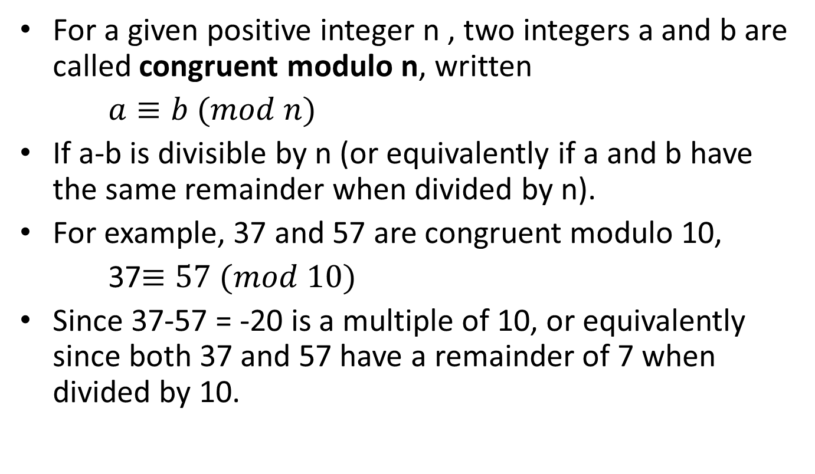

Congruence Modulo $(≡)$
For a given positive integer n , two integers a and b are called congruent modulo n, written
$a≡b (mod n)$
If a-b is divisible by n (or equivalently if a and b have the same remainder when divided by n).
For example, 37 and 57 are congruent modulo 10,
37$≡57 (mod 10)$
Since 37-57 = -20 is a multiple of 10, or equivalently since both 37 and 57 have a remainder of 7 when divided by 10.

Slide 59
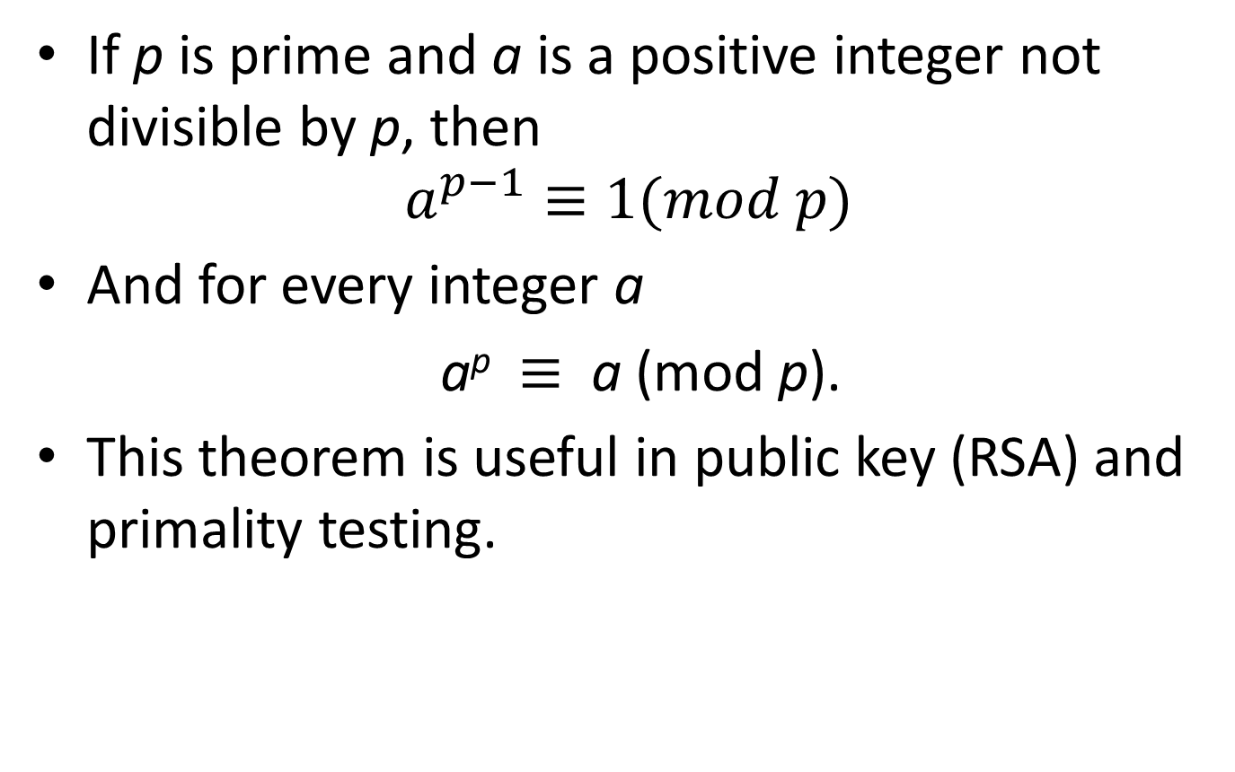
Fermat’s Theorem
If p is prime and a is a positive integer not divisible by p, then
$$a^{p−1}≡1(mod p)$$
And for every integer a
a^{p} $≡$ a (mod p).
This theorem is useful in public key (RSA) and primality testing.

Slide 60
Fermat’s Theorem Proof
Set of positive integers less than p:
{1,2,….(p-1)}
Multiply each element by a modulo p
{a mod p, 2a mod p, ……. , (p-1)a mod p}
No elements in X is equal to zero
No two integers in X are equal

Slide 61
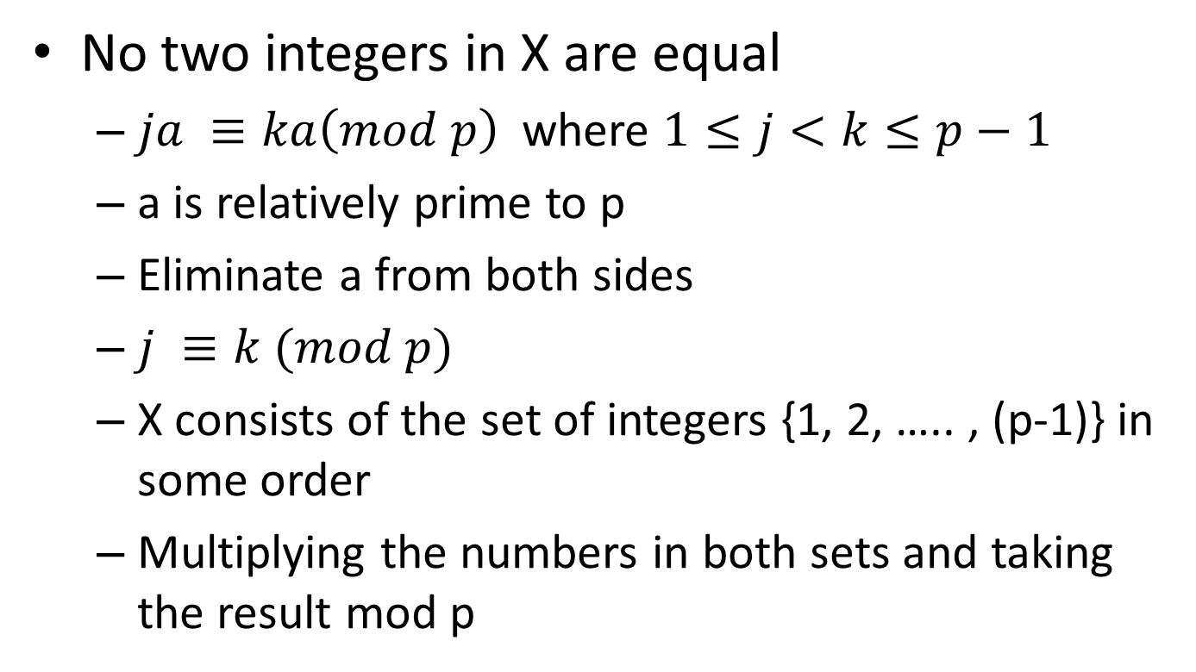
Fermat’s Theorem Proof
No two integers in X are equal
$ja ≡ka\left(mod p\right)$ where $1≤j<k≤p−1$
a is relatively prime to p
Eliminate a from both sides
$j ≡k (mod p)$
X consists of the set of integers {1, 2, ….. , (p-1)} in some order
Multiplying the numbers in both sets and taking the result mod p

Slide 62
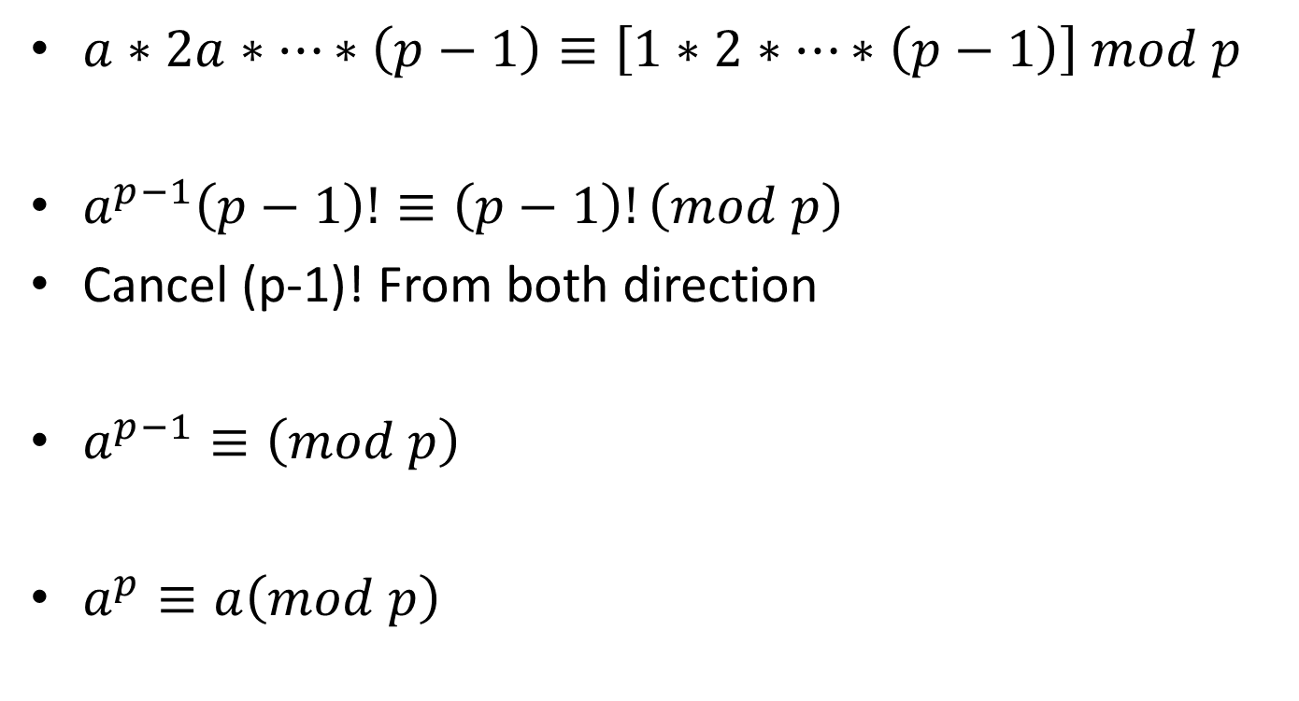
Fermat’s Theorem Proof
$a∗2a∗…∗\left(p−1\right)≡\left[1∗2∗…∗\left(p−1\right)\right] mod p$
$a^{p−1}\left(p−1\right)!≡\left(p−1\right)!\left(mod p\right)$
Cancel (p-1)! From both direction
$a^{p−1}≡\left(mod p\right)$
$a^{p}≡a\left(mod p\right)$

Slide 63

Fermat’s Theorem Proof
p = 5 , a = 3
$a^{p}=3^{5}=243≡3\left(mod 5\right)=a(mod p)$

Slide 64
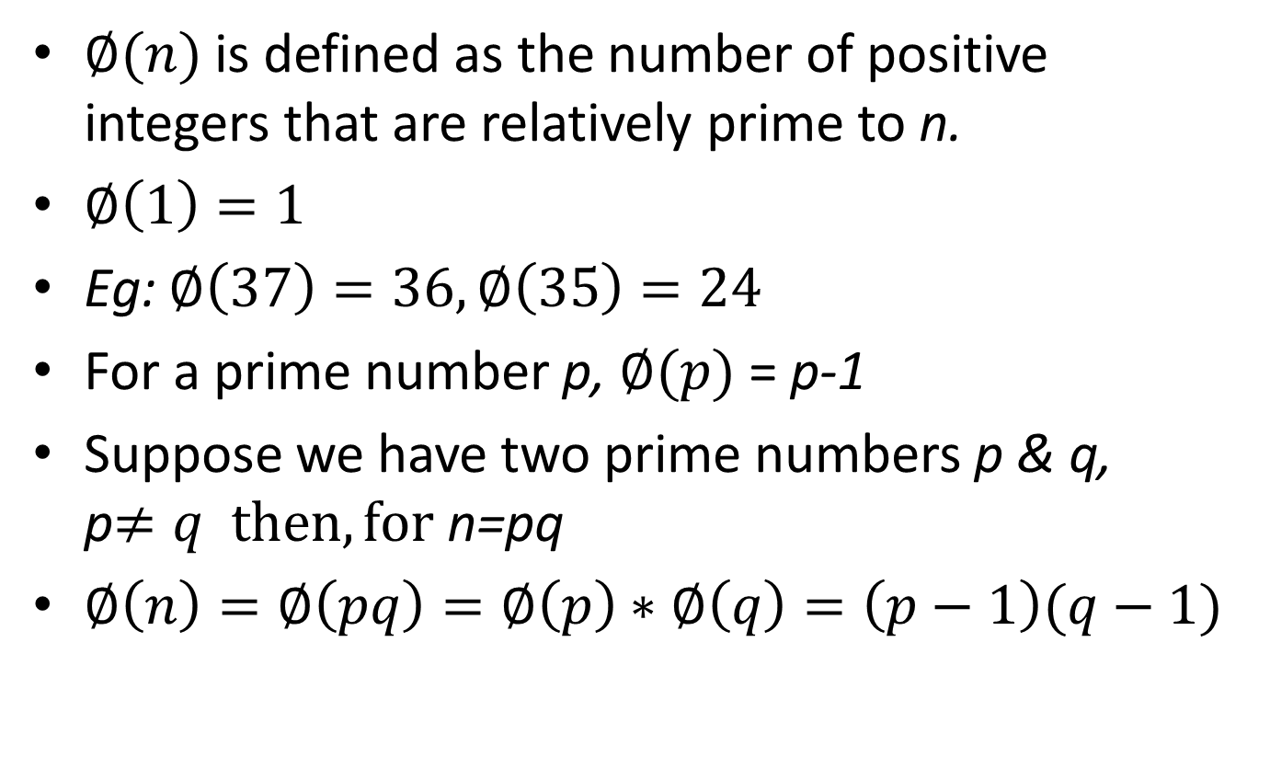
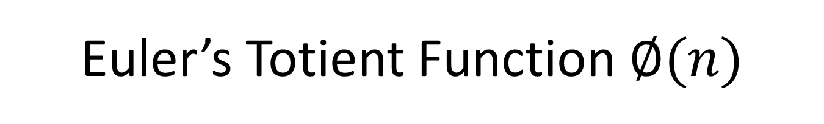
Euler’s Totient Function $∅(n)$
$∅(n)$ is defined as the number of positive integers that are relatively prime to n.
$∅\left(1\right)=1$
Eg: $∅\left(37\right)=36,∅\left(35\right)=24$
For a prime number p, $∅(p)$ = p-1
Suppose we have two prime numbers p & q, p$≠q then, for$ n=pq
$∅\left(n\right)=∅\left(pq\right)=∅\left(p\right)∗∅\left(q\right)=\left(p−1\right)(q−1)$

Slide 65
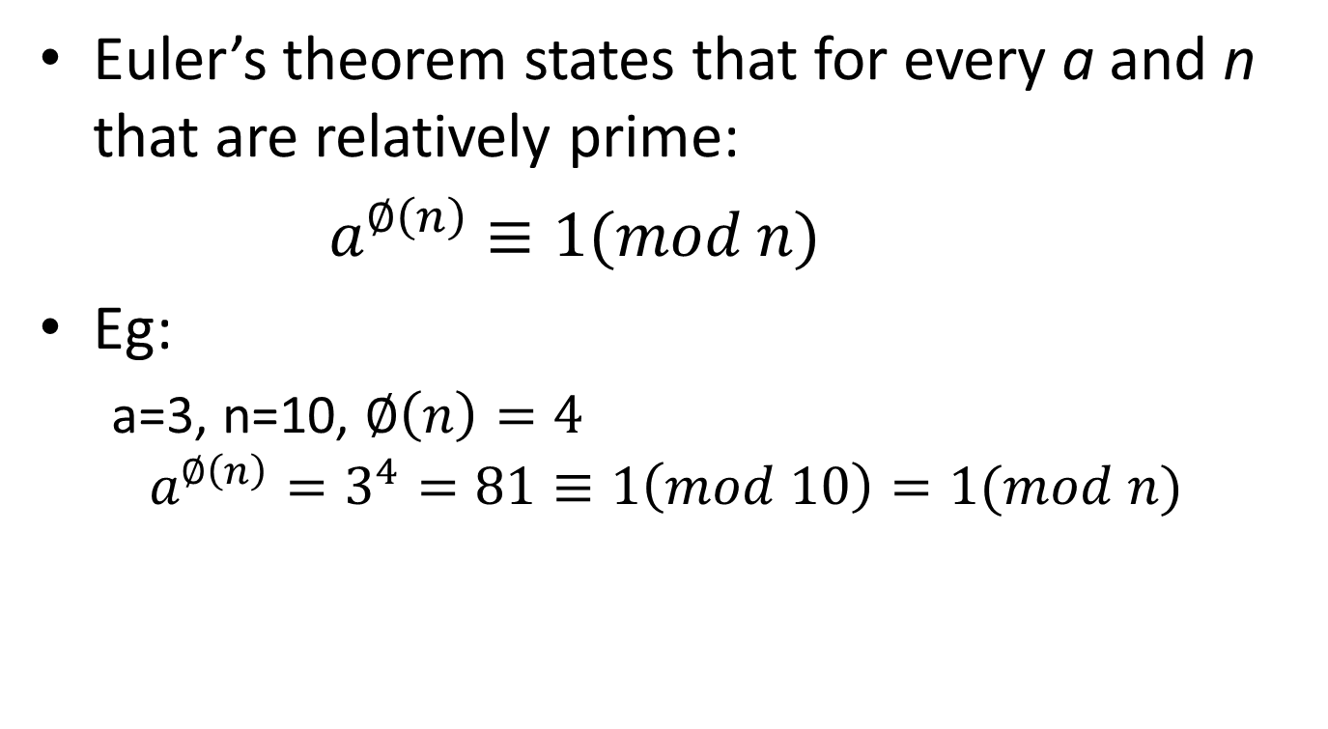
Euler’s Theorem
Euler’s theorem states that for every a and n that are relatively prime:
$a^{∅\left(n\right)}≡1(mod n)$
Eg:
a=3, n=10, $∅\left(n\right)=4$
$$a^{∅\left(n\right)}=3^{4}=81≡1\left(mod 10\right)=1(mod n)$$

Slide 66
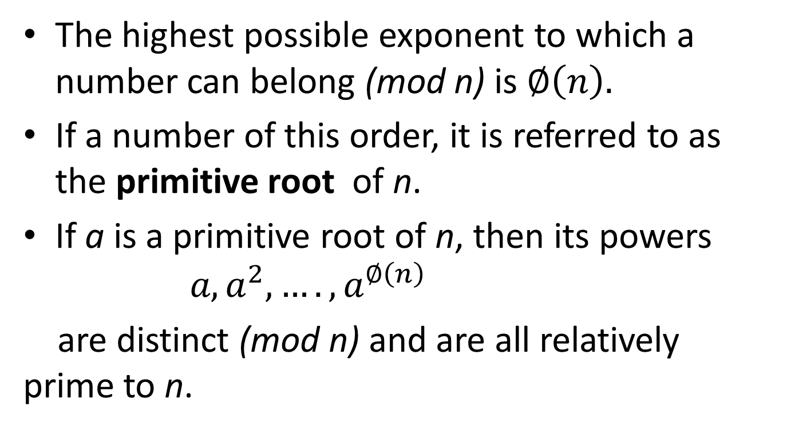
Primitive Root
The highest possible exponent to which a number can belong (mod n) is $∅\left(n\right).$
If a number of this order, it is referred to as the primitive root of n.
If a is a primitive root of n, then its powers $a, a^{2},….,a^{∅\left(n\right)}$
are distinct (mod n) and are all relatively prime to n.

Slide 67
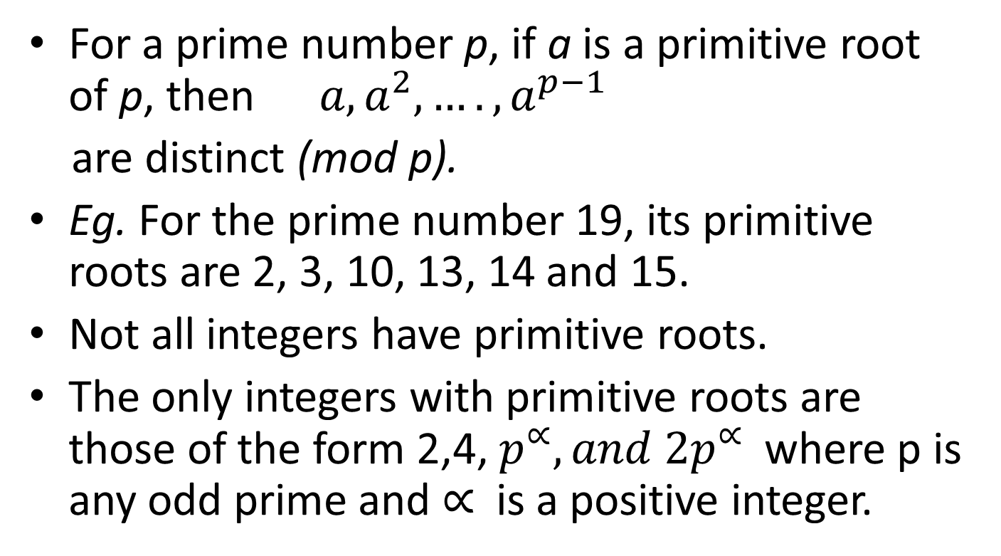
Primitive Root
For a prime number p, if a is a primitive root of p, then $a, a^{2},….,a^{p−1}$
are distinct (mod p).
Eg. For the prime number 19, its primitive roots are 2, 3, 10, 13, 14 and 15.
Not all integers have primitive roots.
The only integers with primitive roots are those of the form 2,4, $p^{∝}, and 2p^{∝}$where p is any odd prime and $∝$ is a positive integer.

Slide 68
Private key Cryptography
Traditional private/secret/single key cryptography uses one key
Shared by both sender and receiver
If this key is disclosed, communications are compromised
Also is symmetric, parties are equal
Hence does not protect sender from receiver forging a message & claiming is sent by sender

Slide 69
Public key Cryptography
Probably most significant advance in the 3000 year history of cryptography
Uses two keys – a public & a private key
Asymmetric since parties are not equal
Uses clever application of number theoretic concepts to function.
Algorithms based on mathematical functions rather than on substitution and permutation ie. Based on number theory.

Slide 70
Public key Cryptography
Developed to address two key issues:
key distribution – how to have secure communications in general without having to trust a KDC with your key.
digital signatures – how to verify a message comes intact from the claimed sender.

Slide 71
Public key Cryptography
Public-key/two-key/asymmetric cryptography involves the use of two keys:
a public-key, which may be known by anybody, and can be used to encrypt messages, and verify signatures
a related private-key, known only to the recipient, used to decrypt messages, and sign (create) signatures
Infeasible to determine private key from public
Is asymmetric because
those who encrypt messages or verify signatures cannot decrypt messages or create signatures

Slide 72
Public key Cryptosystems
Asymmetric algorithms rely on one key for encryption and a different but related key for decryption.
Characteristics:
It is computationally infeasible to determine the decryption key given only knowledge of the cryptographic algorithm and the encryption key.
Either of the two related keys can be used for encryption, with the other used for decryption.

Slide 73
Public key Cryptosystems
6 Ingredients
Plaintext
Encryption algorithm
Public key
Private key
Ciphertext
Decryption algorithm

Slide 74
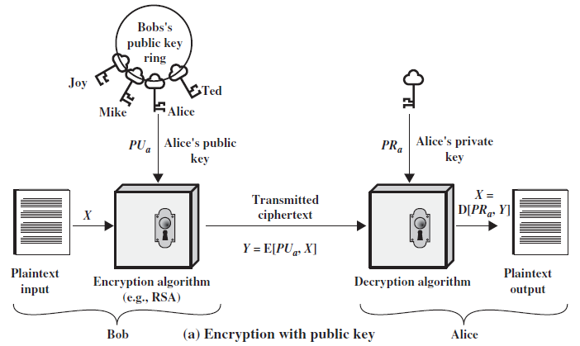
Public key Cryptography – Encryption using Public key

Slide 75
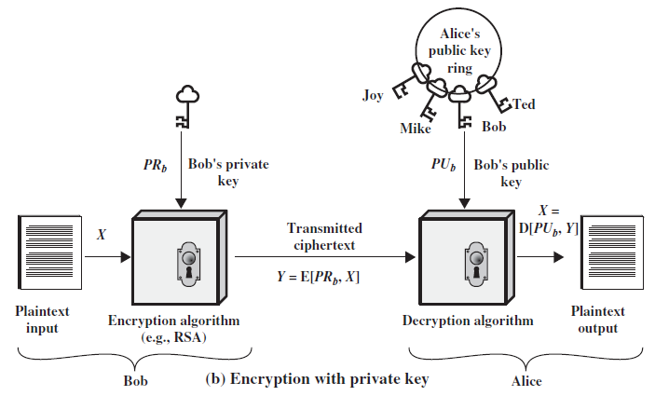
Public key Cryptography – Encryption using Private key

Slide 76
Steps to do Public key encryption
1. Each user generates a pair of keys to be used for the encryption and decryption of messages.
2. Each user places one of the two keys in a public register or other accessible file. This is the public key.The companion key is kept private.
3. If Bob wishes to send a confidential message to Alice, Bob encrypts the message using Alice’s public key.
4. When Alice receives the message, she decrypts it using her private key. No other recipient can decrypt the message because only Alice knows Alice’s private key.

Slide 77
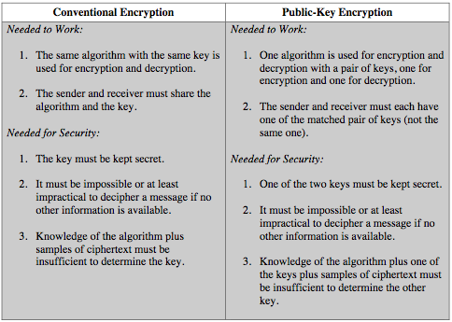
Symmetric vs Public key

Slide 78
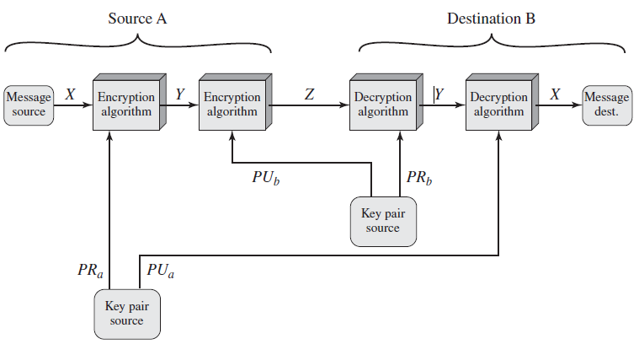
Public-Key Cryptosystem: Authentication and Secrecy

Slide 79
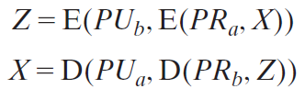
Public-Key Cryptosystem: Authentication and Secrecy

Slide 80
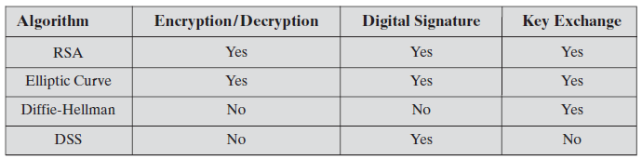
Applications for Public key Cryptosystems
Can classify uses into 3 categories:
encryption/decryption (provide secrecy)
digital signatures (provide authentication)
key exchange (of session keys)
Some algorithms are suitable for all uses, others are specific to one.

Slide 81
Requirements for Public-Key Cryptography
1. It is computationally easy for a party B to generate a pair (public key PUb, private key PRb).
2. It is computationally easy for a sender A, knowing the public key and the message to be encrypted,M, to generate the corresponding ciphertext:
C = E(PUb,M).
3. It is computationally easy for the receiver B to decrypt the resulting ciphertext using the private key to recover the original message:
M = D(PRb, C) = D[PRb, E(PUb,M)]
4. It is computationally infeasible for an adversary, knowing the public key, PUb, to determine the private key, PRb.
5. It is computationally infeasible for an adversary, knowing the public key, PUb, and a ciphertext, C, to recover the original message,M.
6. The two keys can be applied in either order:
M = D[PUb, E(PRb,M)] = D[PRb, E(PUb,M)]

Slide 82
Requirements for Public-Key Cryptography
Need a trapdoor one-way function
A trapdoor function is a function that is easy to compute in one direction, yet difficult to compute in the opposite direction (finding its inverse) without special information, called the "trapdoor".
One-way function has
Y = f(X) easy
X = f^{–1}(Y) infeasible
A trap-door one-way function has
Y = f_{k}(X) easy, if k and X are known
X = f_{k}^{–1}(Y) easy, if k and Y are known
X = f_{k}^{–1}(Y) infeasible, if Y known but k not known
A practical public-key scheme depends on a suitable trap-door one-way function

Slide 83
Public key Cryptanalysis
A public-key encryption scheme is vulnerable to a brute-force attack. The countermeasure is the same: Use large keys.
The complexity of calculating the mathematical functions may not scale linearly with the number of bits in the key but grow more rapidly than that.
Thus, the key size must be large enough to make brute-force attack impractical but small enough for practical encryption and decryption.
Another form of attack is to find some way to compute the private key given the public key.
Finally, another form of attack that is peculiar to public-key systems is, a probable-message attack. This attack can be thwarted by appending some random bits to such simple messages.

Slide 84
RSA
By Rivest, Shamir & Adleman of MIT in 1977.
Best known & widely used public-key scheme.
Block cipher in which the plaintext and ciphertext are integers between 0 and n-1 for some n.
Typical size of n is 1024 bits or 309 decimal digits.
Based on exponentiation in a finite (Galois) field over integers modulo a prime.
Security due to cost of factoring large numbers.

Slide 85

RSA En/Decryption
Plaintext is encrypted in blocks.
Encryption and decryption are of the following form, for some plaintext block M and ciphertext block C.
Both sender and receiver must know the value of n.
The sender knows the value of e, and only the receiver knows the value of d.
Thus, this is a public-key encryption algorithm with a public key of PU = {e, n} and a private key of PR = {d, n}.

Slide 86
RSA
It is possible to find values of e, d, n such that $M^{ed}$ mod n = M for all M < n.
It is relatively easy to calculate $M^{e}$mod n and $C^{d}$mod n for all values of M < n.
It is infeasible to determine d given e and n.

Slide 87
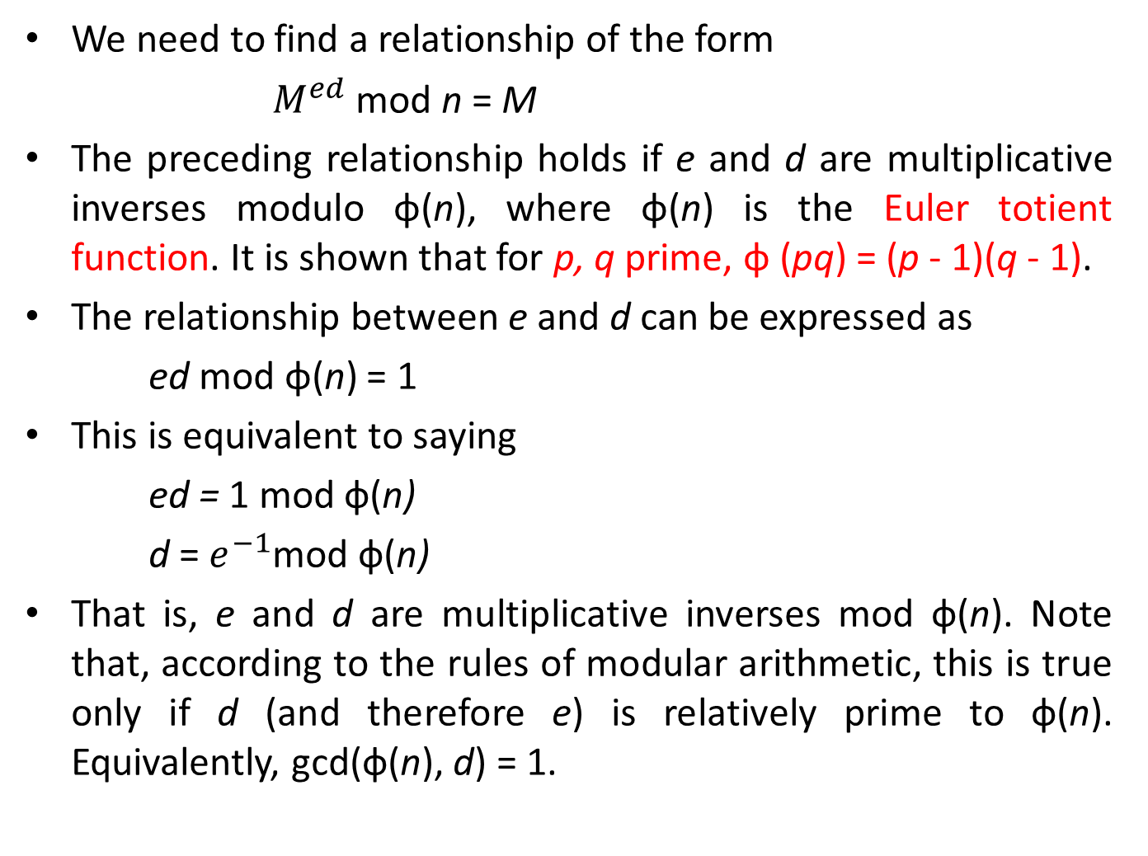
RSA
We need to find a relationship of the form
$M^{ed}$ mod n = M
The preceding relationship holds if e and d are multiplicative inverses modulo φ(n), where φ(n) is the Euler totient function. It is shown that for p, q prime, φ (pq) = (p - 1)(q - 1).
The relationship between e and d can be expressed as
ed mod φ(n) = 1
This is equivalent to saying
ed = 1 mod ф(n)
d = $e^{−1}$mod ф(n)
That is, e and d are multiplicative inverses mod ф(n). Note that, according to the rules of modular arithmetic, this is true only if d (and therefore e) is relatively prime to ф(n). Equivalently, gcd(ф(n), d) = 1.

Slide 88
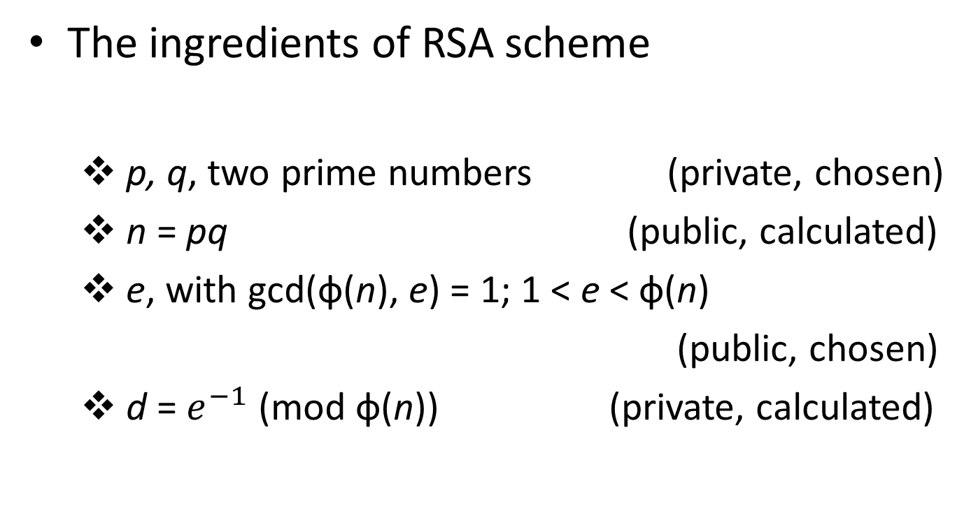
RSA
The ingredients of RSA scheme
p, q, two prime numbers (private, chosen)
n = pq (public, calculated)
e, with gcd(ф(n), e) = 1; 1 < e < ф(n)
(public, chosen)
d = $e^{−1}$ (mod ф(n)) (private, calculated)

Slide 89
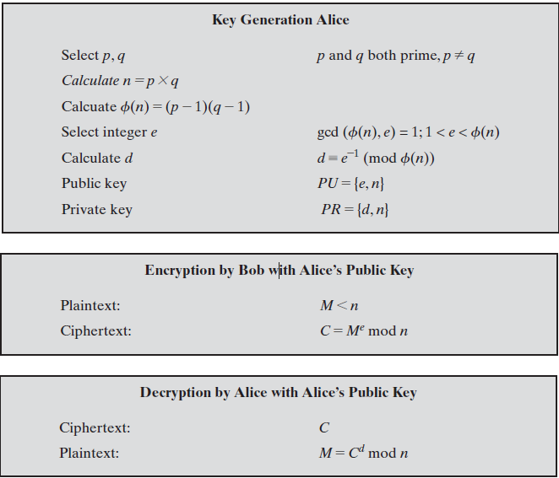
RSA Algorithm

Slide 90
RSA Example – Key Generation
Select two prime numbers, p = 17 and q = 11.
Calculate n = pq = 17 × 11 = 187.
Calculate ф(n) = (p - 1)(q - 1) = 16 × 10 = 160.
Select e such that e is relatively prime to ф(n) = 160 and less than ф(n);ie. gcd(e, ф(n))=1, we choose e = 7.
Determine d such that de = 1 (mod 160) and d < 160. The correct value is d = 23, because 23 × 7 = 161 = (1 × 160) + 1; d can be calculated using the extended Euclid’s algorithm.
Publish public key PU={7,187}
Keep secret private key PR={23,187}

Slide 91
RSA Example En/Decryption
Given message
M = 88 (nb. 88<187)
Encryption:
C = 88⁷ mod 187 = 11
Decryption:
M = 11²³ mod 187 = 88

Slide 92
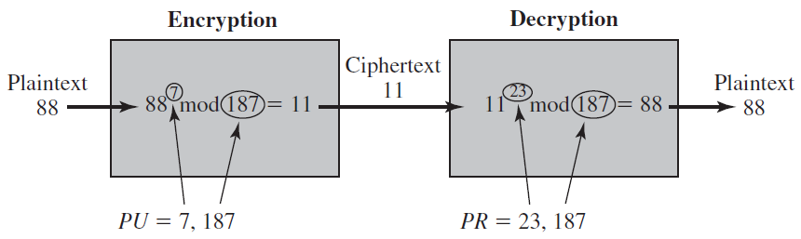
RSA Example En/Decryption

Slide 93
RSA Key Generation
The tasks involved in generation of pair of keys:
Determining two prime numbers, p and q.
Selecting either e or d and calculating the other.
The procedure for picking a prime number is as follows.
Pick an odd integer n at random (e.g., using a pseudorandom number generator).
Pick an integer a < n at random.
Perform the probabilistic primality test, such as Miller-Rabin, with a as a parameter. If n fails the test, reject the value n and go to step 1.
If n has passed a sufficient number of tests, accept n; otherwise, go to step 2.

Slide 94
The Security of RSA
Four possible approaches to attacking the RSA algorithm are
Brute force: This involves trying all possible private keys.
Mathematical attacks: There are several approaches, all equivalent in effort to factoring the product of two primes.
Timing attacks: These depend on the running time of the decryption algorithm.
Chosen ciphertext attacks: This type of attack exploits properties of the RSA algorithm.

Slide 95
Factoring Problem
We can identify three approaches to attacking RSA mathematically.
Factor n into its two prime factors. This enables calculation of ф(n) = (p - 1) ×(q - 1), which in turn enables determination of d = $e^{−1}$ (mod ф(n)).
Determine ф(n) directly, without first determining p and q. Again, this enables determination of d = $e^{−1}$ (mod ф(n)).
Determine d directly, without first determining ф(n).

Slide 96
Factoring Problem
The algorithm’s inventors suggest the following constraints on p and q.
p and q should differ in length by only a few digits.Thus, for a 1024-bit key (309 decimal digits), both p and q should be on the order of magnitude of 1075 to 10100.
Both (p - 1) and (q - 1) should contain a large prime factor.
gcd(p - 1, q - 1) should be small.

Slide 97
Timing Attack
A timing attack is somewhat analogous to a burglar guessing the combination of a safe by observing how long it takes for someone to turn the dial from number to number.
Simple countermeasures for timing attack.
Constant exponentiation time: Ensure that all exponentiations take the same amount of time before returning a result. This is a simple fix but does degrade performance.
Random delay: Better performance could be achieved by adding a random delay to the exponentiation algorithm to confuse the timing attack. Kocher points out that if defenders don’t add enough noise, attackers could still succeed by collecting additional measurements to compensate for the random delays.
Blinding: Multiply the ciphertext by a random number before performing exponentiation. This process prevents the attacker from knowing what ciphertext bits are being processed inside the computer and therefore prevents the bit-by-bit analysis essential to the timing attack.

Slide 98
Diffie – Hellman Key Exchange
The purpose of the algorithm is to enable two users to securely exchange a key that can then be used for subsequent encryption of messages.
The Diffie-Hellman algorithm depends for its effectiveness on the difficulty of computing discrete logarithms.

Slide 99
Key Management
Two aspects
Distribution of public keys
Public announcement
Publicly available directory
Public key authority
Public key certificates
Use of public key encryption to distribute secrete keys
Simple secrete key distribution
Secrete key distribution with confidentiality and authentication

Slide 100
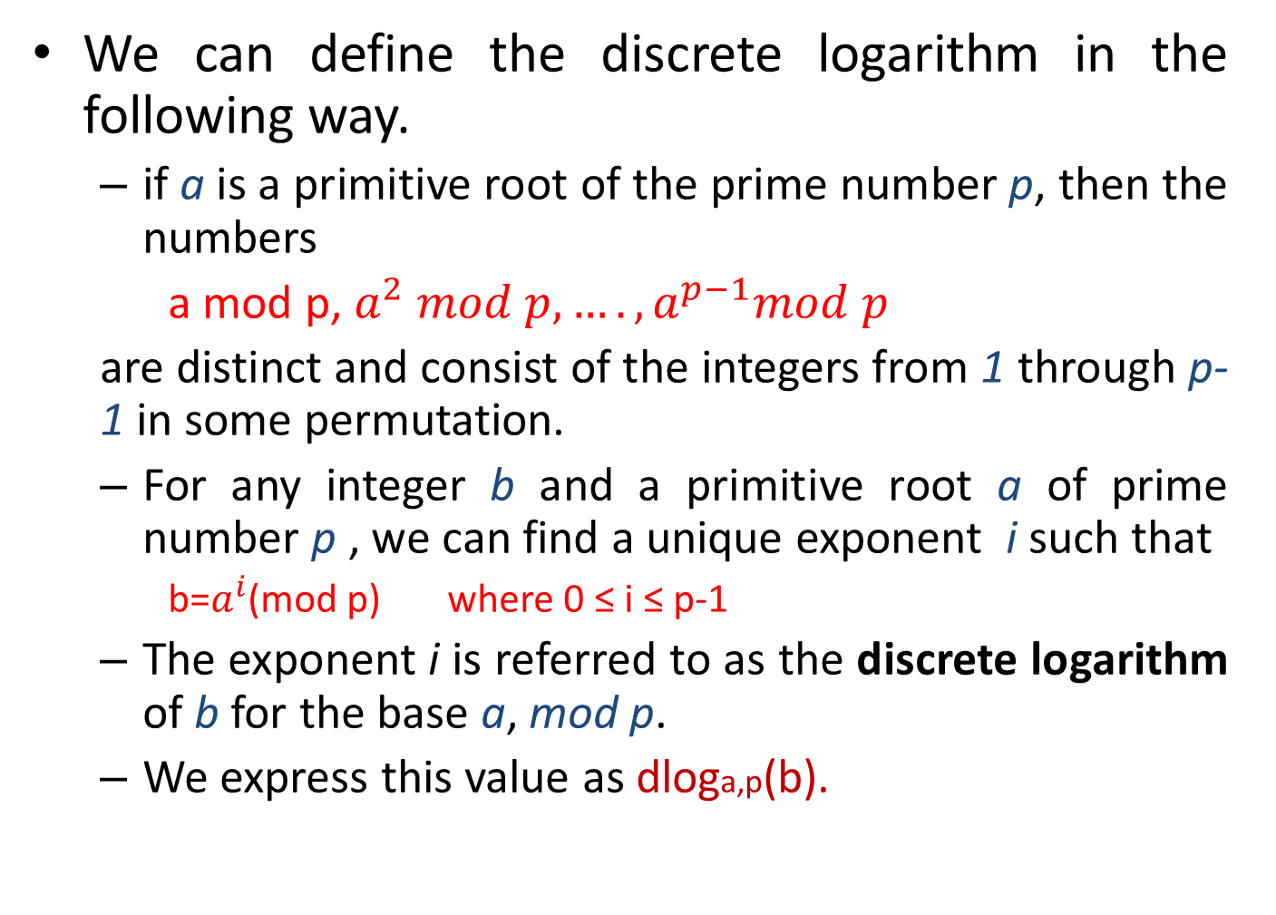
Diffie – Hellman Key Exchange
We can define the discrete logarithm in the following way.
if a is a primitive root of the prime number p, then the numbers
a mod p, $a^{2} mod p,….,a^{p−1}mod p$
are distinct and consist of the integers from 1 through p-1 in some permutation.
For any integer b and a primitive root a of prime number p , we can find a unique exponent i such that
b=$a^{i}$(mod p) where 0 ≤ i ≤ p-1
The exponent i is referred to as the discrete logarithm of b for the base a, mod p.
We express this value as dloga,p(b).

Slide 101
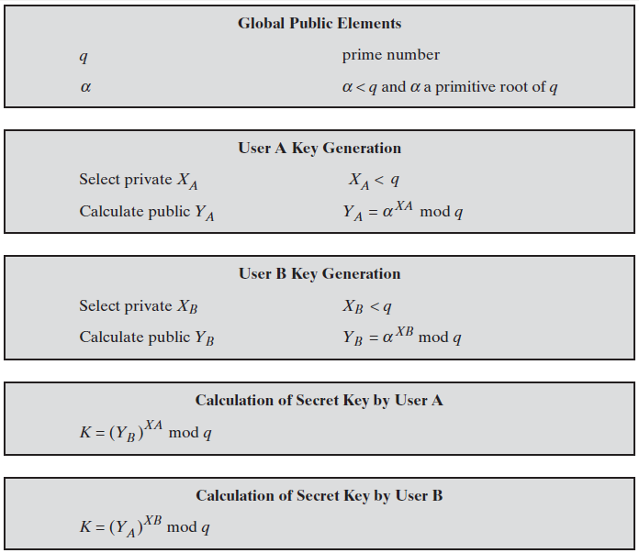
Diffie – Hellman Key Exchange

Slide 102
Diffie – Hellman Key Exchange
The security of the Diffie-Hellman key exchange lies in the fact that, while it is relatively easy to calculate exponentials modulo a prime, it is very difficult to calculate discrete logarithms.

Slide 103
Example
Users Alice & Bob who wish to swap keys:
Agree on prime number q=353 and primitive root of q is α=3
Select random secret keys:
x_{A}=97, (Alice)
x_{B}=233 (Bob)

Slide 104
Example
Compute respective public keys:
y_{A}=3⁹⁷ mod 353 = 40 (Alice)
y_{B}=3²³³ mod 353 = 248 (Bob)
After exchanging the public keys each can compute shared session key as:
K_{AB} = y_{B}^{xA} mod 353
= 248⁹⁷ mod 353 (Alice)
= 160
K_{AB} = y_{A}^{xB} mod 353
= 40²³³ mod 353 (Bob)
= 160

Slide 105
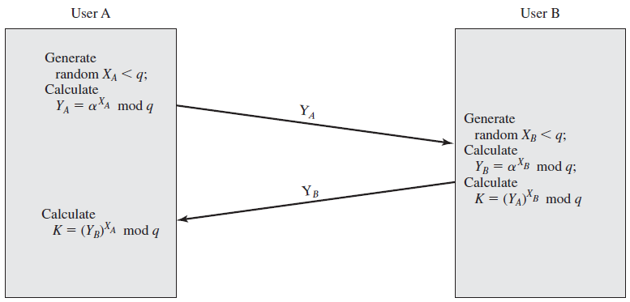
Key Exchange Protocols

Slide 106
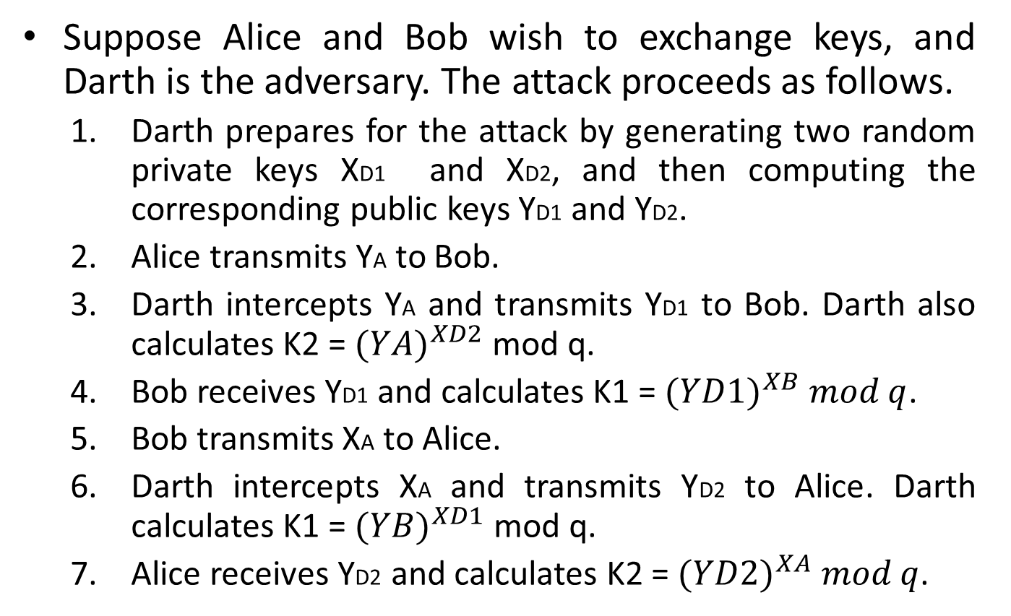
Man-in-the-Middle Attack
Suppose Alice and Bob wish to exchange keys, and Darth is the adversary. The attack proceeds as follows.
Darth prepares for the attack by generating two random private keys XD1 and XD2, and then computing the corresponding public keys YD1 and YD2.
Alice transmits YA to Bob.
Darth intercepts YA and transmits YD1 to Bob. Darth also calculates K2 = ${(YA)}^{XD2}$ mod q.
Bob receives YD1 and calculates K1 = ${(YD1)}^{XB} mod q$.
Bob transmits XA to Alice.
Darth intercepts XA and transmits YD2 to Alice. Darth calculates K1 = ${(YB)}^{XD1}$ mod q.
Alice receives YD2 and calculates K2 = ${(YD2)}^{XA} mod q$.

Slide 107
Man-in-the-Middle Attack
At this point, Bob and Alice think that they share a secret key, but instead Bob and Darth share secret key and Alice and Darth share secret key . All future communication between Bob and Alice is compromised in the following way.
Alice sends an encrypted message M:E(K2,M) .
Darth intercepts the encrypted message and decrypts it to recover M.
Darth sends Bob E(K1,M) or E(K1,M’), where M’ is any message. In the first case, Darth simply wants to eavesdrop on the communication without altering it. In the second case, Darth wants to modify the message going to Bob.
The key exchange protocol is vulnerable to such an attack because it does not authenticate the participants. This vulnerability can be overcome with the use of digital signatures and public-key certificates;

Slide 108
Elliptic Curve Cryptography

